Slide 1
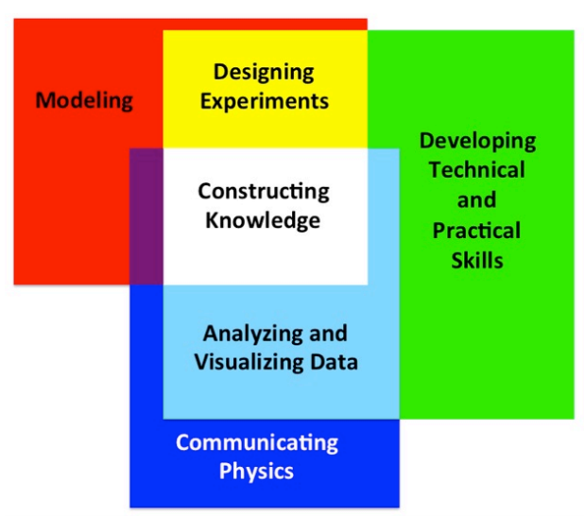
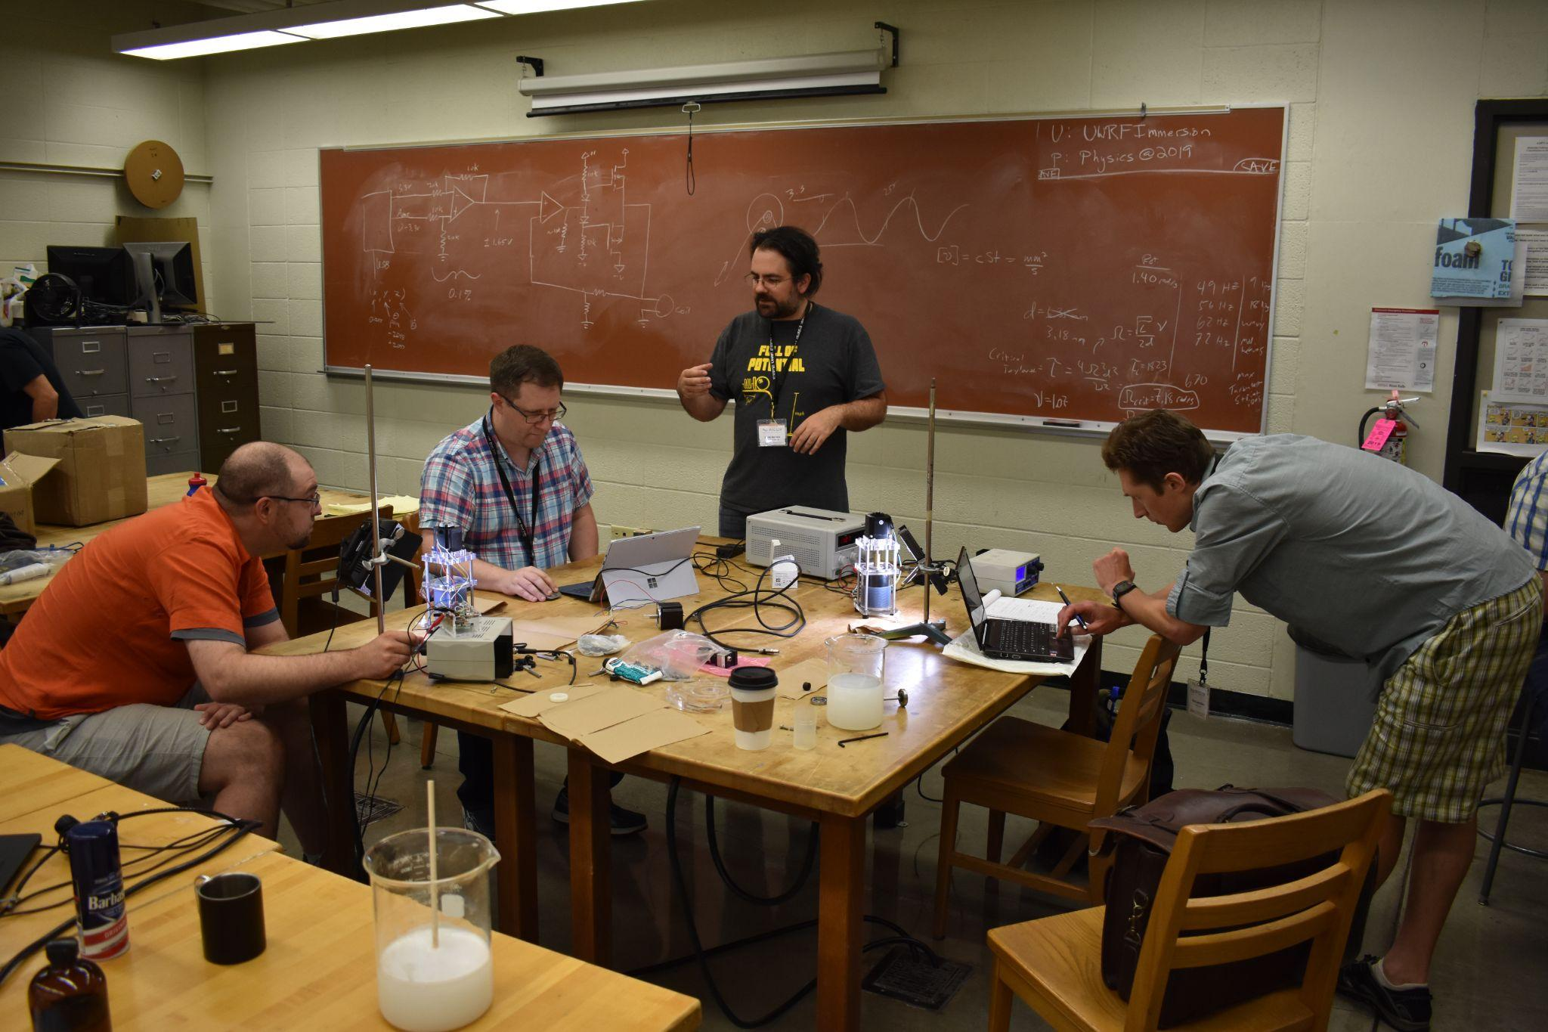
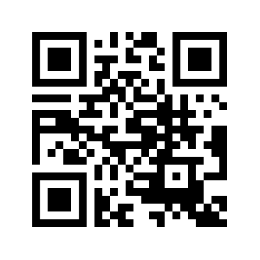
Check us out at www.advlab.org
Let the Advanced Laboratory Physics Association (ALPhA) help you!
Goals
provide communication and interaction among instructors
support and enhance advanced experimental physics education
Organizational Structure
4 officers + board members
14 regions
300+ members worldwide
Partners
ALPhA is the group that nurtures and supports all aspects of advanced lab instruction.
ALPhA achieves its mission by:
Conferences: Providing conferences and workshops on advanced experimental instruction.
Immersions: Holding multi-day training sessions for instructors to learn how to use advanced laboratory equipment. Equipment grants are available to immersion participants!
Generating funding and resources: Curricular Resources on Compadre and at AAPT, Equipment Giveaways, Single Photon Detector Initiative
Supporting National Awards: Jonathan F. Reichert and Barbara Wolff-Reichert Award for Excellence in Advanced Laboratory Instruction, SPS-AAPT-ALPhA Undergraduate Award for Outstanding Laboratory Development
TAKE PART IN AN IMMERSION
CHECK OUT OUR RESOURCES
JOIN OUR ROBUST, BROAD-BASED AND PASSIONATE COMMUNITY!

